Slide 1

Lecture 10
Sizing & Box Model
Notes:
Welcome to this M1 in SQL Course. In this first chapter of the course, we are going to do an introduction of databases and relational databases.

Slide 2

A G E N D A
Height/Width
Margin
Padding
Box Model

Slide 3
Height/Width
Notes:
Without further adieu, Let’s look at the course introduction so that you will know what you are going to learn.

Slide 4
CSS Height/Width
Custom width/height for HTML elements.
Either in pixels, or in percentage
Percentage is relative to the container.
HTML
CSS
<p>I am a paragraph</p>
p {
border: 1px solid red;
width: 100%;
height: 30px;
}
30px
width: 100%;

Slide 5
Half Width
Notice the difference when we set the width to 50% of the container
HTML
CSS
<p>I am a paragraph</p>
p {
border: 1px solid red;
width: 50%;
height: 30px;
}
30px
width: 50%;

Slide 6
Min/Max Width
Note:
We can also set min-height similar to min-width
We can set a max-width constraint.
This will ensure the width of the <p> tag never exceeds a certain value.
We can also set a min-width value.
HTML
CSS
<p>I am a paragraph</p>
p {
border: 1px solid red;
width: 50%;
max-width: 200px;
height: 30px;
}
30px
max-width: 200px;

Slide 7
Margin

Slide 8
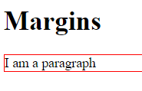
CSS Margin
Margins are applied to elements for allocating space outside its designated borders
HTML
CSS
<h1>Margins</h1>
<p>I am a paragraph</p>
#p {
color: 1px solid red;
}
NO MARGIN APPLIED

Slide 9
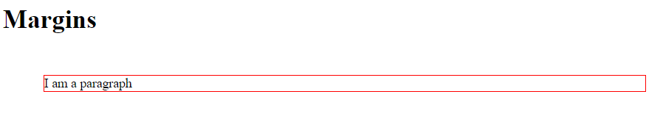
CSS Margin
Margins are used to create space around elements, outside of any defined borders.
HTML
CSS
<h1>Margins</h1>
<p>I am a paragraph</p>
p {
color: 1px solid red;
margin: 50px;
}
50px
50px
50px
50px

Slide 10
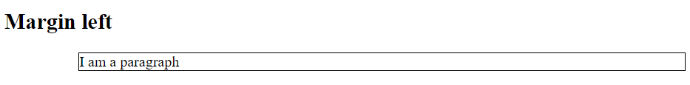
Margin Direction
Margins can also be applied on specific directions
HTML
CSS
<h2>Margin Left</h2>
<p>I am a paragraph</p>
p {
color: 1px solid black;
margin-left: 80px;
}
80px
margin-right / margin-top / margin-bottom are used for right, top and bottom margins respectively

Slide 11
Shorthand Syntax
There are some special margin shortcuts that can be applied to reduce syntax
margin: 25px 50px 75px 100px;
margin: 25px 50px;
  top margin: 25px
  right margin: 50px
  bottom margin: 75px
  left margin: 100px
  top and bottom margins: 25px
  right and left margins: 50px
margin: 25px;
  all four margins are 25px

Slide 12
Padding
Notes:
Without further adieu, Let’s look at the course introduction so that you will know what you are going to learn.

Slide 13
CSS Padding
Padding is applied to elements for allocating space between the content and its designated borders
HTML
CSS
<p>I am a paragraph</p>
p {
border: 1px solid red;
padding: 20px;
}
20px Padding

Slide 14
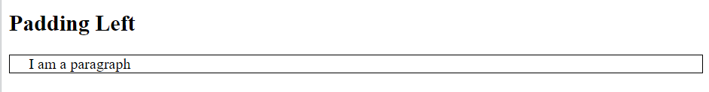
Padding Direction
Padding, like margin, also has specific directions
HTML
CSS
<h2>Padding Left</h2>
<p>I am a paragraph</p>
p {
color: 1px solid black;
padding-left: 20px;
}
20px padding
padding-right / padding-top / padding-bottom are used for right, top and bottom padding

Slide 15
Padding Shorthand
Padding Shorthand
There are some special margin shortcuts that can be applied to reduce syntax
padding: 25px 50px 75px 100px;
padding: 25px 50px;
  top padding: 25px
  right padding: 50px
  bottom padding: 75px
  left padding: 100px
  top and bottom paddings: 25px
  right and left paddings: 50px
padding 25px;
  all four paddings are 25px

Slide 16
Box Model
Notes:
Without further adieu, Let’s look at the course introduction so that you will know what you are going to learn.

Slide 17
Box Model: Margin, Padding and Border
Content
  The main content showcasing text, images etc.
Padding
  Applies space between border and content
  Padding is not visible
Border
  A rectangular strip that encloses the area outside of the padding and content
Margin
  Applies space outside the border
  Margin is not visible
Margin
Border
Padding
Content
Notes:
Without further adieu, Let’s look at the course introduction so that you will know what you are going to learn.

Slide 18

That’s all for this module!
THANK YOU!

